Slide 1
Group Members: Asif Raza MSDS20080 M. Usman MSDS20048 M. Sheraz MSDS20060
WHICH BLOCKCHAIN NETWORK IS MORE PREDICTABLE (ETHEREUM)

Slide 2
Agenda
Motivation
Dataset
Challenges
Literature Reviews
Analysis on Data
ML model’s
Result Set
Conclusion and Future work
Code View

Slide 3
Motivation
Find out the pattern or useful insight from Ethereum Dataset.
Analysis and Visualization.
Future transaction prediction (Link Prediction).
Cluster the same user by analyzing the Transactions of user.

Slide 4
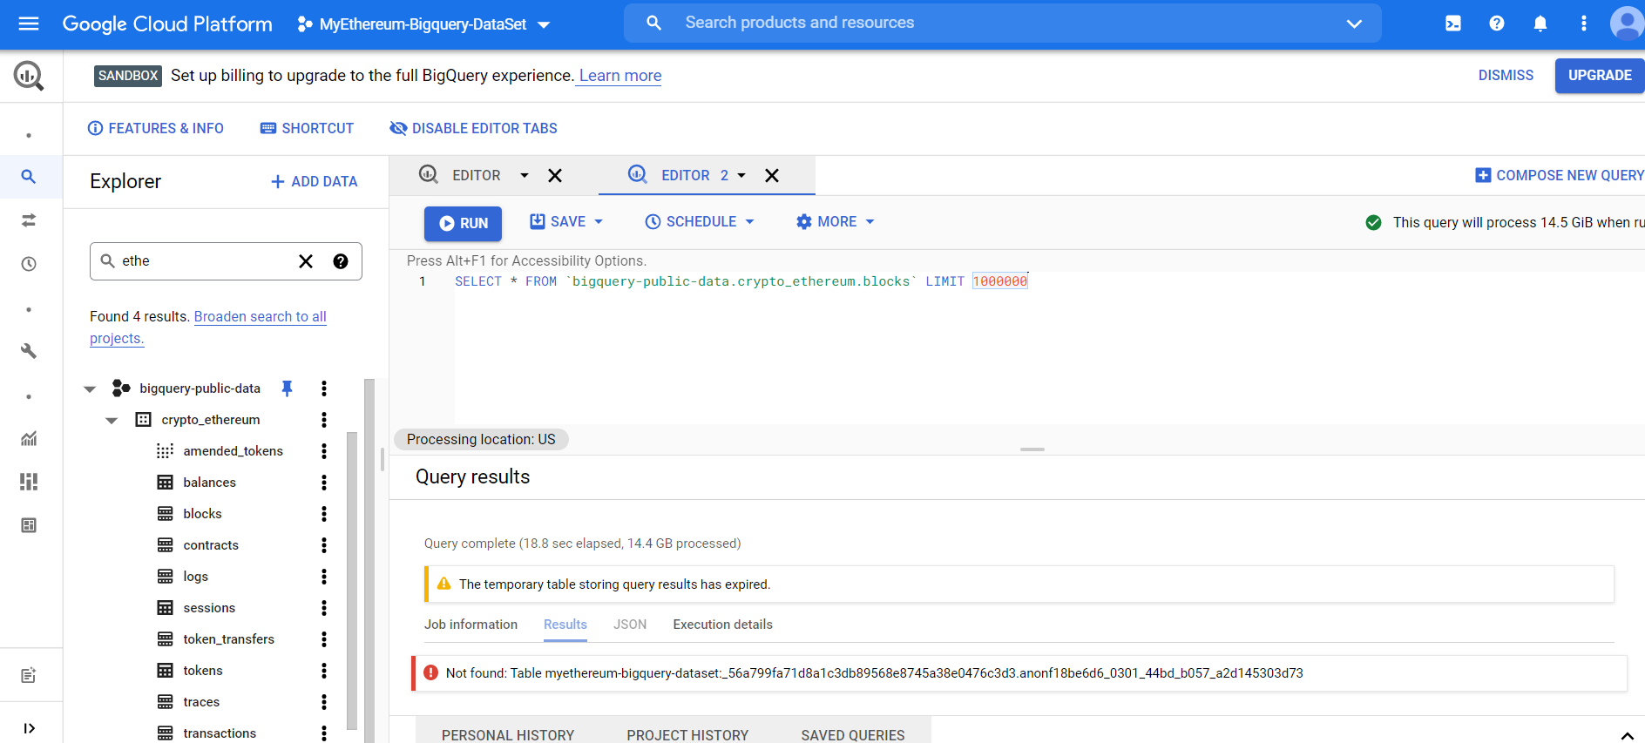
Datasets
Google Cloud Platform (GCP)
Bigquery - Public data set (Ethereum)

Slide 5
Challenges
Download the dataset
Analysis and Implement the ML model for future prediction Data imbalance – consequence of under-fitting
Environment Limitation (LOCAL and COLAB) - 12GB is not enough to train the model in Free Tier Plan on large dataset.
One day transactions of Ethereum is approximately greater than 1 GB.
Due Less amount data set
Visualization problem
Under fit ML model
High Computation Power & Time Require

Slide 6
Literature Review
Detailed analysis of Ethereum network on transaction behavior, community structure and link prediction
Wealth Distribution and Link Predictability in Ethereum
Ethereum transaction graph analysis
Node2vec: Scalable Feature Learning for Networks
Notes:
1 - Detailed Analysis of the Ethereum Network on Transaction Behavior, Community Structure, and Link Prediction (DANET).
2- Ethereum Featured Transactional Network (EFTN) use state-of-the-art Variational Graph Auto-Encoders for link prediction.
3- They produced a model for persisting the the ethereum transaction using Neo4j.
4 - Continuous learning features representation for nodes & learning the mapping of nodes.
to a low dimensional space of features that maximize the likelihood of preserving network neighborhoods of nodes using biased random walk procedure.

Slide 7
Analysis on Ethereum Dataset Different types of queries executed e.g.
Balance
Who has large amount of Ethereum amount balance.
Blocks
Blocks created over the Time i.e. day , month and year.
Top miner, who has created the blocked.
Transaction
Transaction over the Time i.e. day , month and year.
Who has made number of transaction.
Who has received number of transaction.
Contracts
Activities

Slide 8
Machine Learning(ML) Models
Use the Networkx library of python for Graph Representation.
Node2Vac for Graph Embedding
Different types of ML model applied
Logistic Regression
Random Forest Classifier
Gradient Boosting Classifier

Slide 9
Result Set
ACCURACY
Logistic Regression : 86%
Random Forest Classifier : 82%
Gradient Boosting Classifier : 81%
Cluster,
There is issue while cluster the node, because due to less amount of transactions data not showing the cluster wise. Zero clusters against each address/node showing in graph node.

Slide 10
Conclusion & Future Work
Due to machine resources limitations we are unable to train the ML model on large data dataset however, we train less amount of data as per available resource.
Advance Deep Learning model with memory efficient
Custom Framework designed base on Ethereum data (Batches/parallel programming)

Slide 11
Python Code Overview

